Slide 1


Tan Zhen Xuan
06/07/2022

Slide 2

Outline
Executive Summary
Introduction
Methodology
Results
Conclusion
Appendix

Slide 3
Executive Summary
Summary of methodologies used to analyze the data
Data collection using web scraping and the SpaceX API;
Exploratory Data Analysis (EDA), using data wrangling, data visualization, SQL and interactive visual analytics;
Making predictions using machine learning algorithms.
Summary of all results
EDA enabled us to identify prominent features that can better predict success of future launches;
The machine learning algorithms enabled us to select the best model to predict those prominent features.

Slide 4
Introduction
The objective of this project is to determine the viability of Space Y to compete with Space X.
Problems to be answered in the project:
The cost of the launch based on different factors;
Chances of the first stage landing successfully;
Best places to conduct launches.

Slide 5

Section 1

Slide 6
Methodology
Executive Summary
Data collection methodology:
Data from Space X was collected from 2 main sources, namely;
Using the SpaceX API
Web Scraping from Wikipedia
Perform data wrangling
Data collected is analyzed and reinforced by creating a new label called “Landing Outcome”.
This would be used for training the supervised machine learning models down the line.
Perform exploratory data analysis (EDA) using visualization and SQL

Slide 7
Methodology
Executive Summary
Perform interactive visual analytics using Folium and Plotly Dash
Perform predictive analysis using classification models
Data that was collected up till now is preprocessed and divided into training and test data sets to be used by the 4 different classification models.
The accuracy of each model will be determined by different combinations of parameters.

Slide 8
Data Collection
The datasets are collected using the following ways, namely;
SpaceX API
(https://api.spacexdata.com/v4/rockets/ )
From Wikipedia using Web Scraping
The Wikipedia page used is (https://en.wikipedia.org/wiki/List_of_Falcon\_9\_and_Falcon_Heavy_launches)

Slide 9
Data Collection – SpaceX API
Request and parse the SpaceX launch data
Prepare, clean the data and save it to a new dataframe
Replace missing values in the dataframe
Filter the dataframe to only include Falcon 9 launches
The SpaceX REST API is an open-source REST API for obtaining various data about SpaceX.
The API was used according to the flowchart on the right.
Source code: https://github.com/Lonpeace/IBM_data_science_applied_capstone/blob/master/Data%20Collection%20API.ipynb

Slide 10
Data Collection - Scraping
Request the wiki page from its URL
Extract all column/variable names from the HTML table header
Create a new dataframe by parsing the launch html tables
Data from SpaceX launches are also obtained from Wikipedia.
Data is scrapped using BeautifulSoup and cleaned, then saved to a new dataframe.
Source code: https://github.com/Lonpeace/IBM_data_science_applied_capstone/blob/master/Data%20Collection%20with%20Web%20Scraping.ipynb

Slide 11
Data Wrangling
Firstly, some EDA is done on the dataset.
Then, some calculations are done to determine the number of launches on the different sites and the number of occurrence of each orbit.
Lastly, a landing outcome label is created using data from the Outcome column.
Source code: https://github.com/Lonpeace/IBM_data_science_applied_capstone/blob/master/Data%20Wrangling.ipynb

Slide 12
EDA with Data Visualization
To explore and visualize the collected data and the relationship between the different features, scatterplots, bar charts and line charts are used.
The following relationships are plotted in the notebook;
Flight Number against Launch Site, and against Orbit Type
Payload Mass against Launch Site, and against Orbit Type
Orbit Type against Success Rate
Year against Success Rate
Source code: https://github.com/Lonpeace/IBM_data_science_applied_capstone/blob/master/EDA%20with%20Visualization.ipynb

Slide 13
EDA with SQL
The following SQL queries are performed:
Names of the unique launch sites used in the space mission
Display 5 records where launch sites begins with “CCA”
Display the total payload mass carried by boosters launched by NASA
Display the average payload mass carried by booster version “F9 v1.1”
List the date when the first successful landing outcome in ground pad was achieved
List the names of the boosters which have success in drone ship and have payload mass between 4000 and 6000 kg
List the total number of successful and failure mission outcomes
List the names of the booster versions that have carried the max payload mass
List the failed landing outcomes in drone ship, their booster versions and launch site names in the year 2015
Rank the count of landing outcomes between 2010-06-04 and 2017-03-20, in descending order
Source code: https://github.com/Lonpeace/IBM_data_science_applied_capstone/blob/master/EDA%20with%20SQL.ipynb

Slide 14
Build an Interactive Map with Folium
Map objects such as markers, marker clusters, circles and lines are used together with Folium Maps
Markers indicate points of interest on the map
Marker clusters indicate group of events in each coordinate
Circles indicate highlighted areas around specific coordinates
Lines indicate distances between 2 point of interests or coordinates
Source code: https://github.com/Lonpeace/IBM_data_science_applied_capstone/blob/master/Interactive%20Visual%20Analytics%20with%20Folium.ipynb

Slide 15
Build a Dashboard with Plotly Dash
The graphs and plots that were used to visualize the data are as follows;
Pie chart of the Percentage of launches by the different sites
Scatterplot of how payload mass and booster version affects success rate
The plots enables us to analyze the relation between the different features, which allows for quick identification of good launch sites and payload mass to use for successful launches.
Source code: https://github.com/Lonpeace/IBM_data_science_applied_capstone/blob/master/spacex_dash_app.py

Slide 16
Predictive Analysis (Classification)
4 classification models were compared, namely;
Logistic regression
Support Vector machine (SVM)
Decision tree
K Nearest Neighbour (KNN)
Data preparation and standardization
Test each model to get best parameters to use
Compare the accuracy of each of the models
Source code: https://github.com/Lonpeace/IBM_data_science_applied_capstone/blob/master/Machine%20Learning%20Prediction.ipynb

Slide 17
Results
Exploratory data analysis results
Interactive analytics demo in screenshots
Predictive analysis results

Slide 18

Section 2

Slide 19
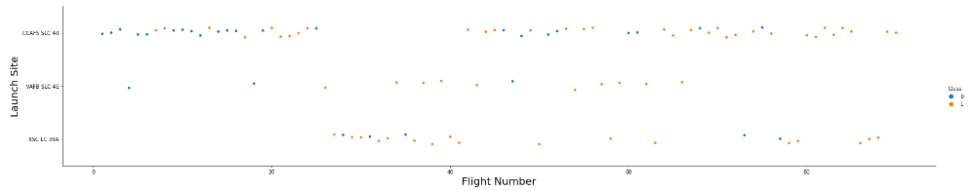
Flight Number vs. Launch Site
From the plot, we can observe that the CCAFS SLC 40 launch site is the more popular choice among the 3 launch sites, as a lot more launches have been made from that launch site as compared to the other 2.
Also, we can derive that the more frequently that a launch site is used, the success rate of that particular launch site will increase.

Slide 20
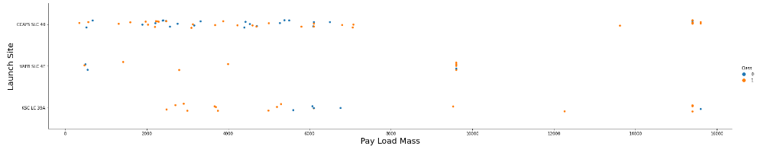
Payload vs. Launch Site
From the chart, we can observe that payloads over the weight of 10,000 kg are only launched from the CCAFS SLC 40 and KSC LC 39A launch sites.

Slide 21
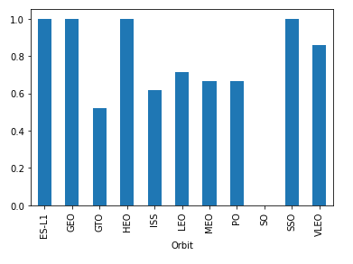
Success Rate vs. Orbit Type
Based on the bar chart, we can observe that the orbit types that have the highest success rates are as follows;
ES-L1
GEO
HEO
SSO
VLEO

Slide 22
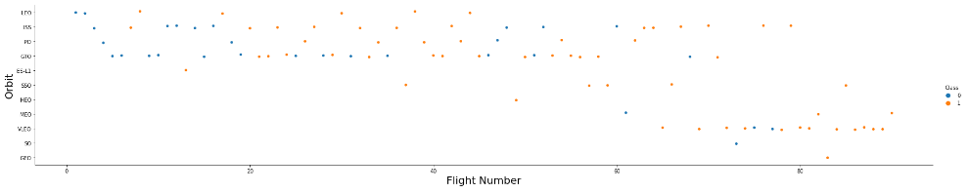
Flight Number vs. Orbit Type
From the chart, we can observe that the success rates for flights increases over time. This is prevalent in the orbit type of LEO, whereas the same cannot be said for the orbit type GTO.
As a side note, SpaceX seems to be taking an interest in the orbit type VLEO, as its frequency has increased as of late.

Slide 23
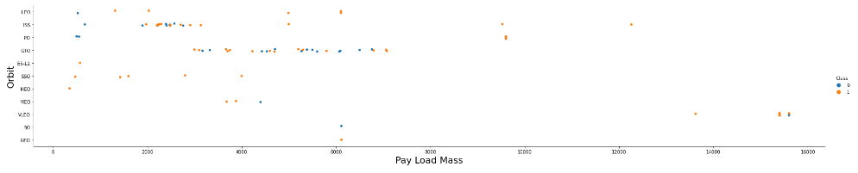
Payload vs. Orbit Type
For the orbit type GTO, we cannot distinguish the whether payload mass influence the success rate of the launch.
For the orbit types Polar, LEO and ISS, it is observed that a heavier payload increases the success rate of the launch.

Slide 24
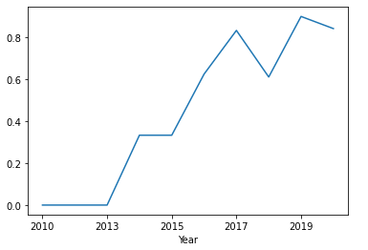
Launch Success Yearly Trend
From the chart, we can observe that the success rate of launches have been steadily improving over the years.
In 2018, it is observed that there was a drop of close to 20% in the success rates of launches.

Slide 25
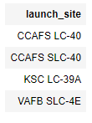
All Launch Site Names
Based on the query results, there are a total of 4 unique launch sites names, namely;
CCAFS LC-40
CCAFS SLC-40
KSC LC-39A
VAFB SLC-4E
The names are obtained by selecting unique occurrences of each value in the ‘launch_site’ column.

Slide 26
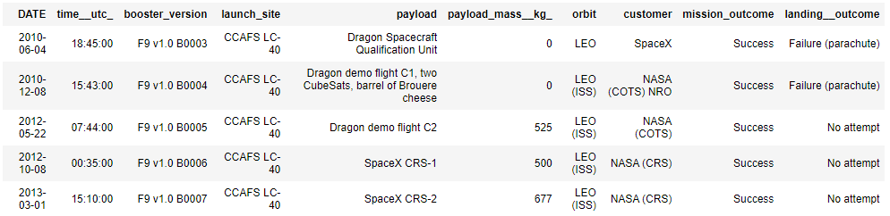
Launch Site Names Begin with 'CCA'
Based on the query results, we can observe 5 records that has a launch site name that begins with ‘CCA’.

Slide 27
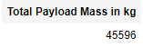
Total Payload Mass
Based on the query result, the total payload mass that is carried by boosters launched by NASA (CRS) is 45,596kg.
The result is obtained by summing up all the payload mass of rows that have NASA (CRS) as the customer.

Slide 28
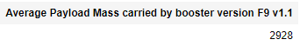
Average Payload Mass by F9 v1.1
Based on the query result, the average payload mass carried by the booster version “F9 v1.1” is 2,928kg.
The result is obtained by filtering the table for rows that have booster version = ‘F9 v1.1’ and taking the average of the payload mass.

Slide 29
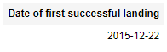
First Successful Ground Landing Date
Based on the query result, the first successful landing occurred on the date 22/12/2015.
This result is obtained by filtering the table for rows with a successful landing outcome and finding the earliest date from those rows.

Slide 30
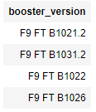
Successful Drone Ship Landing with Payload between 4000 and 6000
Based on the query results, the booster versions that have a successful drone ship landing with a payload between 4000kg and 6000kg are as follows;
F9 FT B1021.2
F9 FT B1031.2
F9 FT B1022
F9 FT B1026
This result is obtained by filtering the table for rows that have a successful landing outcome on a drone ship and a payload mass between 4000kg and 6000kg. We then select each unique occurrences of the booster version.

Slide 31
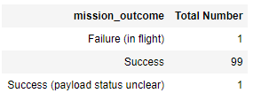
Total Number of Successful and Failure Mission Outcomes
Based on the query results, we can observe that there are 100 successful missions while having only 1 failure.
This result is obtained by grouping the rows with the mission outcome column and counting each occurrence.

Slide 32
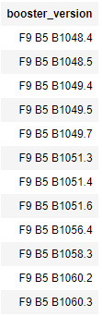
Boosters Carried Maximum Payload
Based on the query result, we can find all the booster versions that have carried the maximum payload mass.
We can obtain the value of the maximum payload mass by using a subquery.

Slide 33
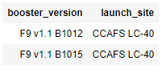
2015 Launch Records
Based on the query result, the booster versions and launch sites that have a failed landing outcome on the drone ship in the year 2015 can be observed above.

Slide 34
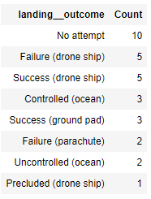
Rank Landing Outcomes Between 2010-06-04 and 2017-03-20
Between 04/06/2010 and 20/03/2017, it can be observed that the number of times that no attempt was made to land the booster was the highest.
This is followed by an equal number of successful landings and unsuccessful landings on drone ships.

Slide 35

Section 3

Slide 36
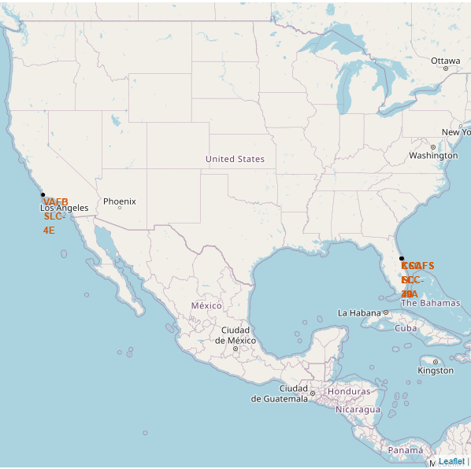
All launch site's location
The screenshot on the left shows all the launch sites used by SpaceX for their rocket launches.
All the launch sites are located near the coastlines.

Slide 37
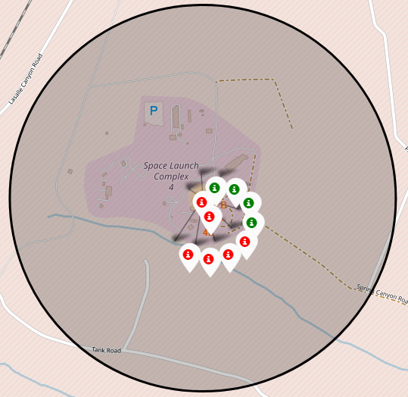
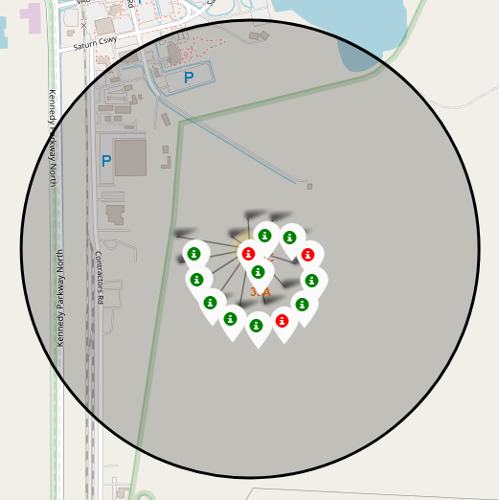
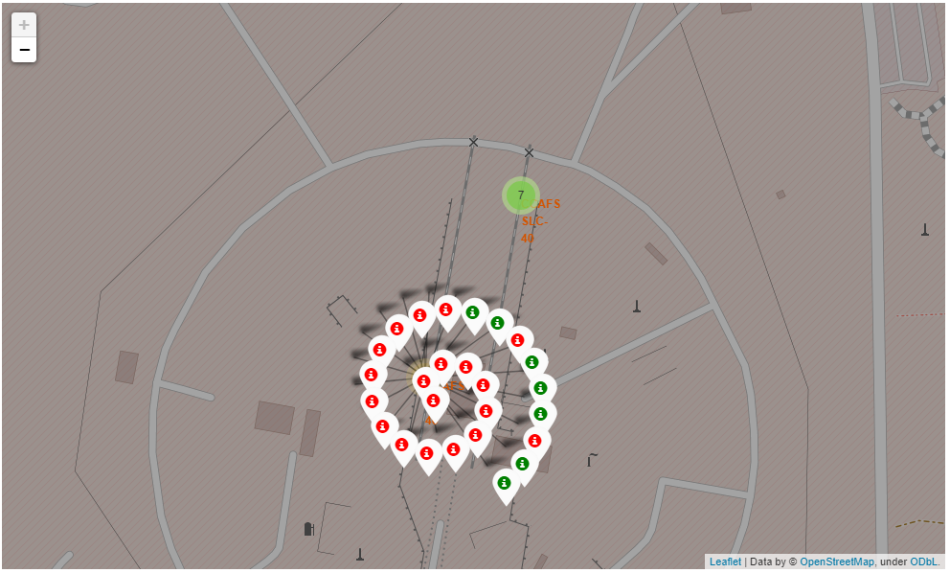
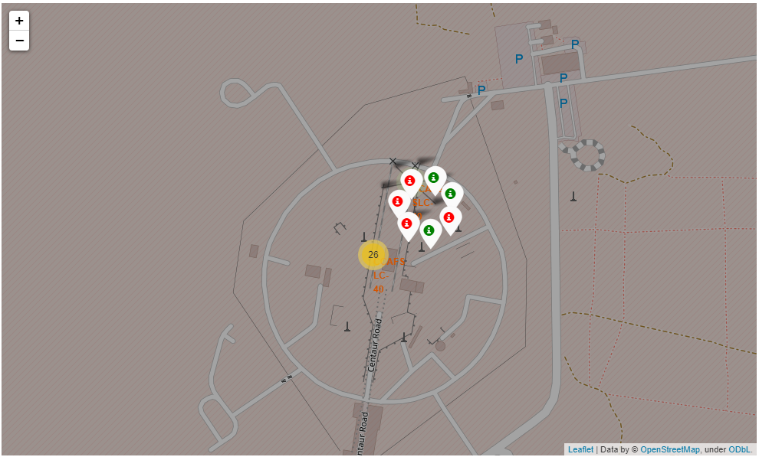
Launch sites with color coded launch outcomes
CCAFS LC-40
CCAFS SLC-40
VAFB SLC-4E
KSC LC-39A
The green markers represent successful launches while the red markers represent unsuccessful launches.

Slide 38
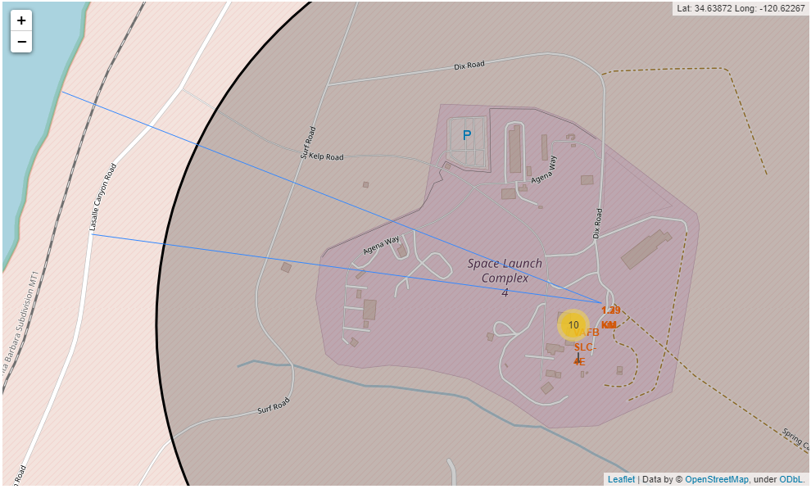
Launch site distance to landmarks
Distance from nearest coastline: 1.39km
Distance from nearest highway: 1.28km
The launch site is located quite close to a coastline and a highway.
It could be located close to the coastline for easy retrieval of the booster after a successful landing.
Being close to a highway also allows for more efficient logistical processes.

Slide 39

Section 4

Slide 40
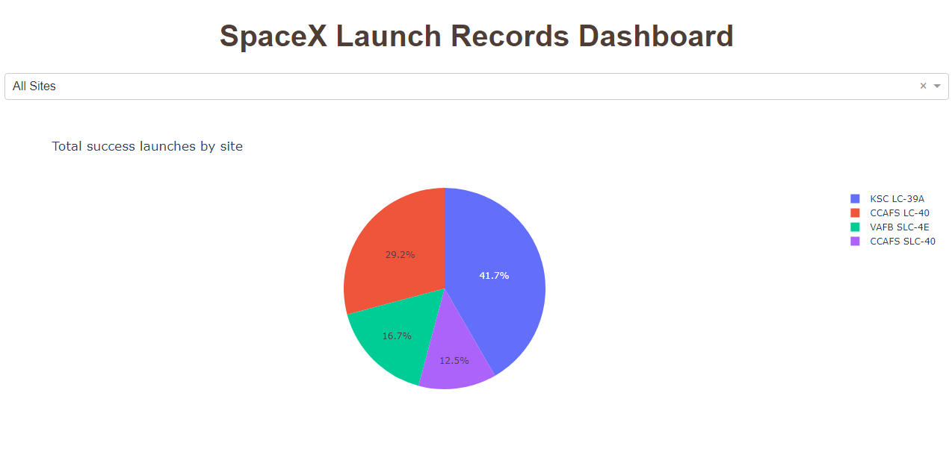
Successful launches for all sites
We can observe that the launch site “KSC LC-39A” has the greatest number of successful launches among the launch sites.
It contributed 41.7% of the total successful launches conducted by SpaceX.

Slide 41
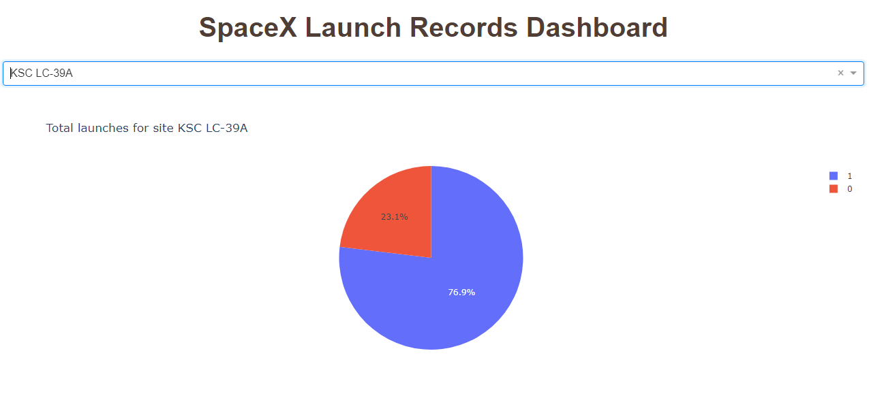
Launch site with the highest launch success ratio
From the dashboard, it can be observed that 76.9% of the launches done in the site is successful.

Slide 42
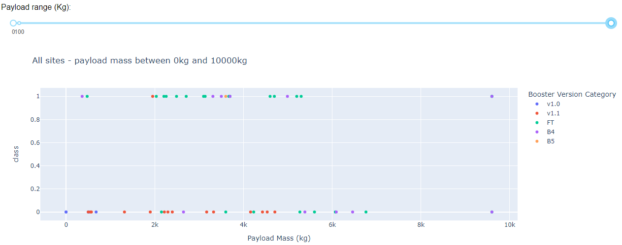
Payload vs Launch Outcome – Full range
It can be observed that the booster version “FT” has the highest success rate among the different booster versions for payloads that are below 6000kg.

Slide 43
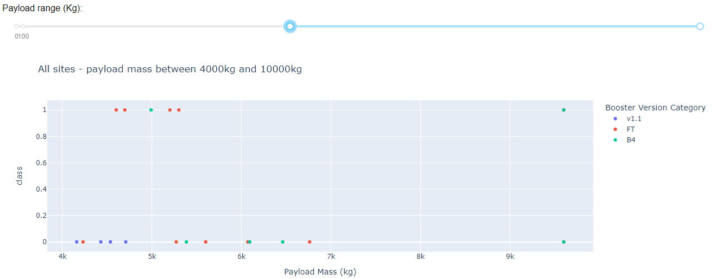
Payload vs Launch Outcome – 4k to 10k
It can be observed that regardless of booster version, the success rate of launches decreases when the payload mass increases beyond 4000kg.

Slide 44

Section 5

Slide 45
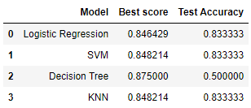
Classification Accuracy
Among the different models used, the decision tree has the highest training accuracy of 0.875. However, its test accuracy is significantly lower than the rest of the models.
The other 3 models have the same testing accuracies.

Slide 46
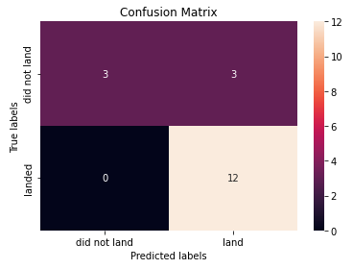
Confusion Matrix
Out of the 4 models, Logistic Regression, SVM and KNN performed equally well with test accuracies of 0.833.
Their confusion matrix is shown on the right.
We can observe that these models can very accurately predict true positives, but the accuracy for true negatives is not very good.

Slide 47
Conclusions
To summarize;
The launch site with the most successful launches is “KSC LC-39A”.
The success rates of launches at a launch site increases over time, as more launches are made.
The orbit types with the highest success rates are the ES-L1, GEO, HEO, SSO and VLEO.
The Logistic Regression model, SVM model and K Nearest Neighbor model can be used to predict whether a future landing will be successful.

Slide 48


